Slide 1
Industry 4.0 concepts
Industry 4.0 refers to a new phase in the Industrial Revolution that focuses heavily on interconnectivity, automation, machine learning, and real-time data. Industry 4.0, also sometimes referred to as IIoT or smart manufacturing, marries physical production and operations with smart digital technology, machine learning, and big data to create a more holistic and better connected ecosystem for companies that focus on manufacturing and supply chain management.

Slide 2
Evolution of Industry from 1.0 to 4.0
There are four distinct industrial revolutions that the world either has experienced or continues to experience today.
The First Industrial Revolution
The first industrial revolution happened between the late 1700s and early 1800s. During this period of time, manufacturing evolved from focusing on manual labor performed by people and aided by work animals to a more optimized form of labor performed by people through the use of water and steam-powered engines and other types of machine tools.

Slide 3
The Second Industrial Revolution
In the early part of the 20th century, the world entered a second industrial revolution with the introduction of steel and use of electricity in factories. The introduction of electricity enabled manufacturers to increase efficiency and helped make factory machinery more mobile. It was during this phase that mass production concepts like the assembly line were introduced as a way to boost productivity.

Slide 4
The Third Industrial Revolution
Starting in the late 1950s, a third industrial revolution slowly began to emerge, as manufacturers began incorporating more electronic—and eventually computer—technology into their factories. During this period, manufacturers began experiencing a shift that put less emphasis on analog and mechanical technology and more on digital technology and automation software.

Slide 5
The Fourth Industrial Revolution or Industry 4.0
In the past few decades, a fourth industrial revolution has emerged, known as Industry 4.0. Industry 4.0 takes the emphasis on digital technology from recent decades to a whole new level with the help of interconnectivity through the Internet of Things (IoT), access to real-time data, and the introduction of cyber-physical systems. Industry 4.0 offers a more comprehensive, interlinked, and holistic approach to manufacturing.

Slide 6
It connects physical with digital, and allows for better collaboration and access across departments, partners, vendors, product, and people. Industry 4.0 empowers business owners to better control and understands every aspect of their operation, and allows them to leverage instant data to boost productivity, improve processes, and drive growth.

Slide 7
Basic IIoT Concepts and Glossary of Terms
Enterprise Resource Planning (ERP): Business process management tools that can be used to manage information across an organization.
IoT: IoT stands for Internet of Things, a concept that refers to connections between physical objects like sensors or machines and the Internet.
IIoT: IIoT stands for the Industrial Internet of Things, a concept that refers to the connections between people, data, and machines as they relate to manufacturing.

Slide 8
Big data: Big data refers to large sets of structured or unstructured data that can be compiled, stored, organized, and analyzed to reveal patterns, trends, associations, and opportunities.
Artificial intelligence (AI): Artificial intelligence is a concept that refers to a computer’s ability to perform tasks and make decisions that would historically require some level of human intelligence.
M2M: This stands for machine-to-machine, and refers to the communication that happens between two separate machines through wireless or wired networks.

Slide 9
Digitization: Digitization refers to the process of collecting and converting different types of information into a digital format.
Smart factory: A smart factory is one that invests in and leverages Industry 4.0 technology, solutions, and approaches.
Machine learning: Machine learning refers to the ability that computers have to learn and improve on their own through artificial intelligence—without being explicitly told or programmed to do so.

Slide 10
Cloud computing: Cloud computing refers to the practice of using interconnected remote servers hosted on the Internet to store, manage, and process information.
Real-time data processing: Real-time data processing refers to the abilities of computer systems and machines too continuously and automatically process data and provides real-time or near-time outputs and insights.

Slide 11
Ecosystem: An ecosystem, in terms of manufacturing, refers to the potential connectedness of your entire operation—inventory and planning, financials, customer relationships, supply chain management, and manufacturing execution.
Cyber-physical systems (CPS): Cyber-physical systems, also sometimes known as cyber manufacturing, refers to an Industry 4.0-enabled manufacturing environment that offers real-time data collection, analysis, and transparency across every aspect of a manufacturing operation.

Slide 12
Smart Manufacturing Use Cases
1. Supply chain management and optimization—Industry 4.0 solutions give businesses greater insight, control, and data visibility across their entire supply chain. By leveraging supply chain management capabilities, companies can deliver products and services to market faster, cheaper, and with better quality to gain an advantage over less-efficient competitors.

Slide 13
2. Predictive maintenance/analytics—Industry 4.0 solutions give manufacturers the ability to predict when potential problems are going to arise before they actually happen. Without IoT systems in place at your factory, preventive maintenance happens based on routine or time. In other words, it’s a manual task. With IoT systems in place, preventive maintenance is much more automated and streamlined. Systems can sense when problems are arising or machinery needs to be fixed, and can empower you to solve potential issues before they become bigger problems.

Slide 14
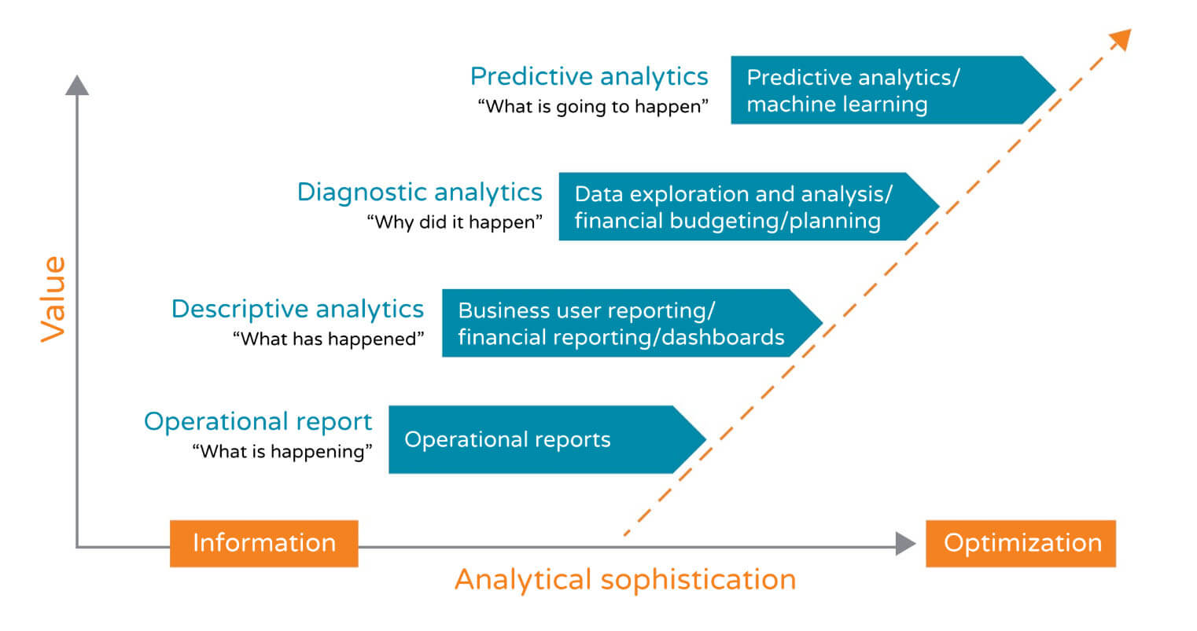

Slide 15
3. Asset tracking and optimization—Industry 4.0 solutions help manufacturers become more efficient with assets at each stage of the supply chain, allowing them to keep a better pulse on inventory, quality, and optimization opportunities relating to logistics. With IoT in place at a factory, employees can get better visibility into their assets worldwide. Standard asset management tasks such as asset transfers, disposals, reclassifications, and adjustments can be streamlined and managed centrally and in real time.

Slide 16
Who Is Industry 4.0 Right For?
You’re in a particularly competitive industry with a lot of tech-savvy players
You’re having a hard time recruiting to fill vacant jobs at your organization
You want better visibility across your supply chain
You want to identify and address issues before they become bigger problems

Slide 17
You want to boost efficiency and profitability across your entire organization
You want everyone on your team to have informed, up-to-date, relevant views of production and business processes
You want richer and more timely analytics
You need help digitizing and making sense of information
You want to improve customer satisfaction and customer experience
You want to improve product quality or keep product quality intact

Slide 18
You want a more integrated enterprise resource planning system that spans not only inventory and planning, but also financials, customer relationships, supply chain management, and manufacturing execution
You want a consistent and flexible view of production and business operations tailored to specific areas or users in your organization
You want real-time insights that help you make better, faster decisions about your business each day

Slide 19
Benefits of Adopting an Industry 4.0 Model
Industry 4.0 spans the entire product life cycle and supply chain— design, sales, inventory, scheduling, quality, engineering, and customer and field service. Everyone shares informed, up-to-date, relevant views of production and business processes—and much richer and timelier analytics.
Here is a quick, non-exhaustive list of some of the benefits of adopting an Industry 4.0 model for your business:

Slide 20
It makes you more competitive, especially against disruptors like Amazon. As companies like Amazon continue to optimize logistics and supply chain management, you need to be investing in technology and solutions that help you improve and optimize your own operation. To stay competitive, you have to have the systems and processes in place to allow you to provide the same level of service (or better) to your customers and clients that they could be getting from a company like Amazon.

Slide 21
Raspberry Pi
IoT Device
A "Thing" in Internet of Things (IoT) can be any object that has a unique identifier and which can send/receive data (including user data) over a network (e.g., smart phone, smart TV, computer, refrigerator, car, etc.).
• IoT devices are connected to the Internet and send information about themselves or about their surroundings (e.g. information sensed by the connected sensors) over a network (to other devices or servers/storage) or allow actuation upon the physical entities/environment around the remotely.

Slide 22
IoT Device Examples
A home automation device that allows remotely monitoring the status of appliances and controlling the appliances.
• An industrial machine which sends information about its operation and health monitoring data to a server.
• A car which sends information about its location to a cloud-based service.
• A wireless-enabled wearable device that measures data about a person such as the number of steps walked and sends the data to a cloud-based service.

Slide 23
Raspberry Pi
Raspberry Pi is a low-cost mini-computer with the physical size of a credit card. Raspberry Pi runs various flavors of Linux and can perform almost all tasks that a normal desktop computer can do. Raspberry Pi also allows interfacing sensors and actuators through the general purpose I/O pins. Since Raspberry Pi runs Linux operating system, it supports Python "out of the box".

Slide 24
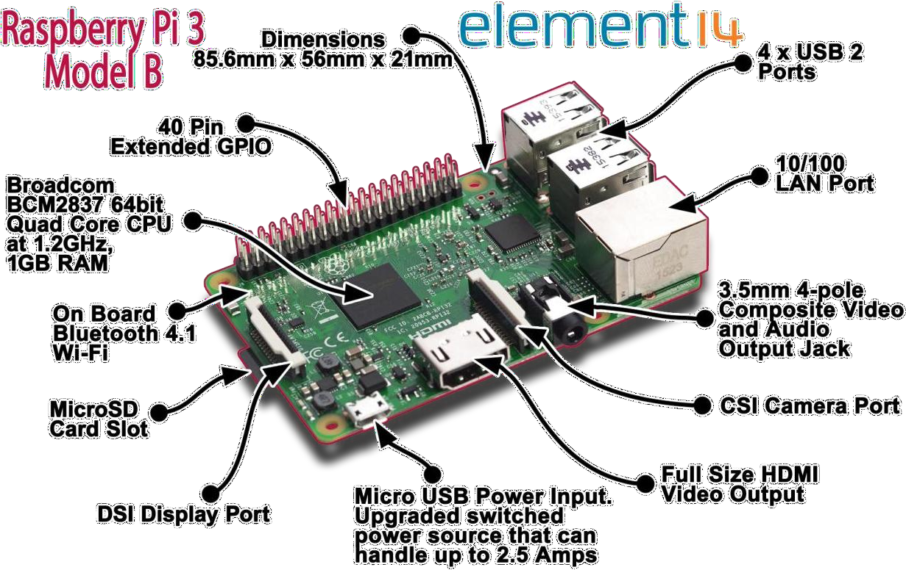

Slide 25
Specifications and performance
As for the specifications, the Raspberry Pi is a credit card-sized computer powered by the Broadcom BCM2835 system-on-a-chip (SoC). This SoC includes a 32-bit ARM1176JZFS processor, clocked at 700MHz, and a Video core IV GPU.
It also has 256MB of RAM in a POP package above the SoC. The Raspberry Pi is powered by a 5V micro USB AC charger or at least 4 AA batteries (with a bit of hacking).

Slide 26
 | Raspberry pi 3 model B | Raspberry pi 2 model B | Raspberry Pi zero
RAM | 1GB SDRAM | 1GB SDRAM | 512 MB SDRAM
CPU | Quad cortex A53@1.2GHz | Quad cortex A53@900MHz | ARM 11@ 1GHz
GPU | 400 MHz video core IV | 250 MHz video core IV | 250 MHz video core IV
Ethernet | 10/100 | 10/100 | None
Wireless | 802.11/Bluetooth 4.0 | None | None
Video output | HDMI/Composite | HDMI/Composite | HDMI/Composite
GPIO | 40 | 40 | 40

Slide 27
Raspberry Pi Basics: installing Raspbian and getting it up and running
1. Downloading Raspbian and Image writer.
You will need an image writer to write the downloaded OS into the SD card. So download the "win32 disk imager" from the website.
2. Writing the image
Insert the SD card into the laptop/pc and run the image writer. Once open, browse and select the downloaded Raspbian image file. Select the correct device that is the drive representing the SD card. If the drive (or device) selected is different from the SD card then the other selected drive will become corrupted. SO be careful.

Slide 28
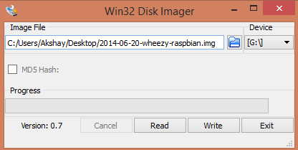
After that, click on the "Write" button in the bottom. As an example, see the image below, where the SD card (or micro SD) drives is represented by the letter "G:\"

Slide 29
3. Setting up the Pi
Please remember that after booting the Pi, there might be situations when the user credentials like the "username" and password will be asked. Raspberry Pi comes with a default user name and password and so always use it whenever it is being asked. The credentials are:
Login: pi
Password: raspberry
When the Pi has been booted for the first time, a configuration screen called the "Setup Options" should appear and it will look like the image below.

Slide 30
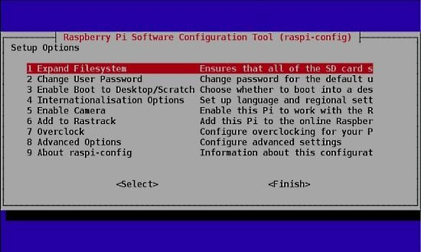
Fig 5.5.Raspberry Configuration

Slide 31
sudoraspi-config
Once you execute this command the "Setup Options" screen will come up as shown in the image above.
Now that the Setup Options window is up, we will have to set a few things. After completing each of the steps below, if it asks to reboot the Pi, please do so. After the reboot, if you don't get the "Setup Options" screen, then follow the command given above to get the screen/window.

Slide 32
The first thing to do:
Select the first option in the list of the setup options window, that is select the "Expand Filesystem" option and hit the enter key. We do this to make use of all the space present on the SD card as a full partition. All this does is, expand the OS to fit the whole space on the SD card which can then be used as the storage memory for the Pi

Slide 33
Select the third option in the list of the setup options window, that is select the "Enable BootTo Desktop/Scratch" option and hit the enter key. It will take you to another window called the "choose boot option" window that looks like the image below.
The second thing to do:

Slide 34
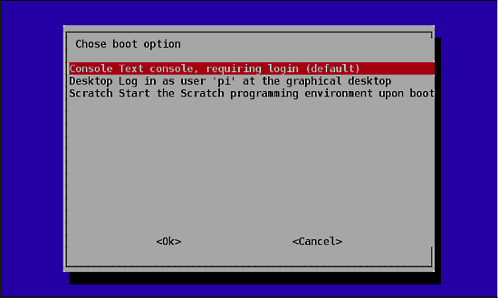
Fig 5.6 Boot Options

Slide 35
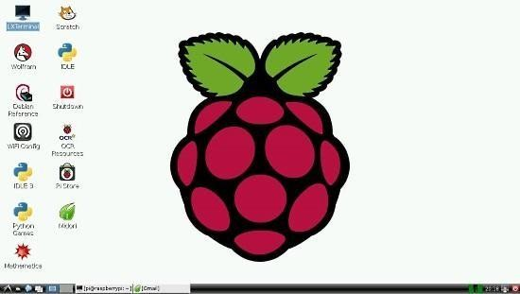
sudo reboot
Updating the firmware
After the reboot from the previous step, if everything went right, then you will end up on the desktop which looks like the image below.

Slide 36
sudorpi-update
Updating the firmware is necessary because certain models of the Pi might not have all the required dependencies to run smoothly or it may have some bug. The latest firmware might have the fix to those bugs, thus its very important to update it in the beginning itself.
5. Conclusions
So, we have covered the steps to get the Pi up and running. This method works on all the different models of Raspberry Pi (model A, B, B+ and also RPi 2) as Raspbain was made to be supported on all models.

Slide 37
However, while installing other software or libraries, the procedure might change a bit while installing depending on the model of the Pi or the version of Raspbian itself.
The concept of Raspberry is to keep trying till you get the result or build that you want. This might involve a lot of trial and error but spending the time will be worth it. The actual usage doesn't end here. This is just the beginning. It is up to you to go ahead to build something amazing out of it.

Slide 38
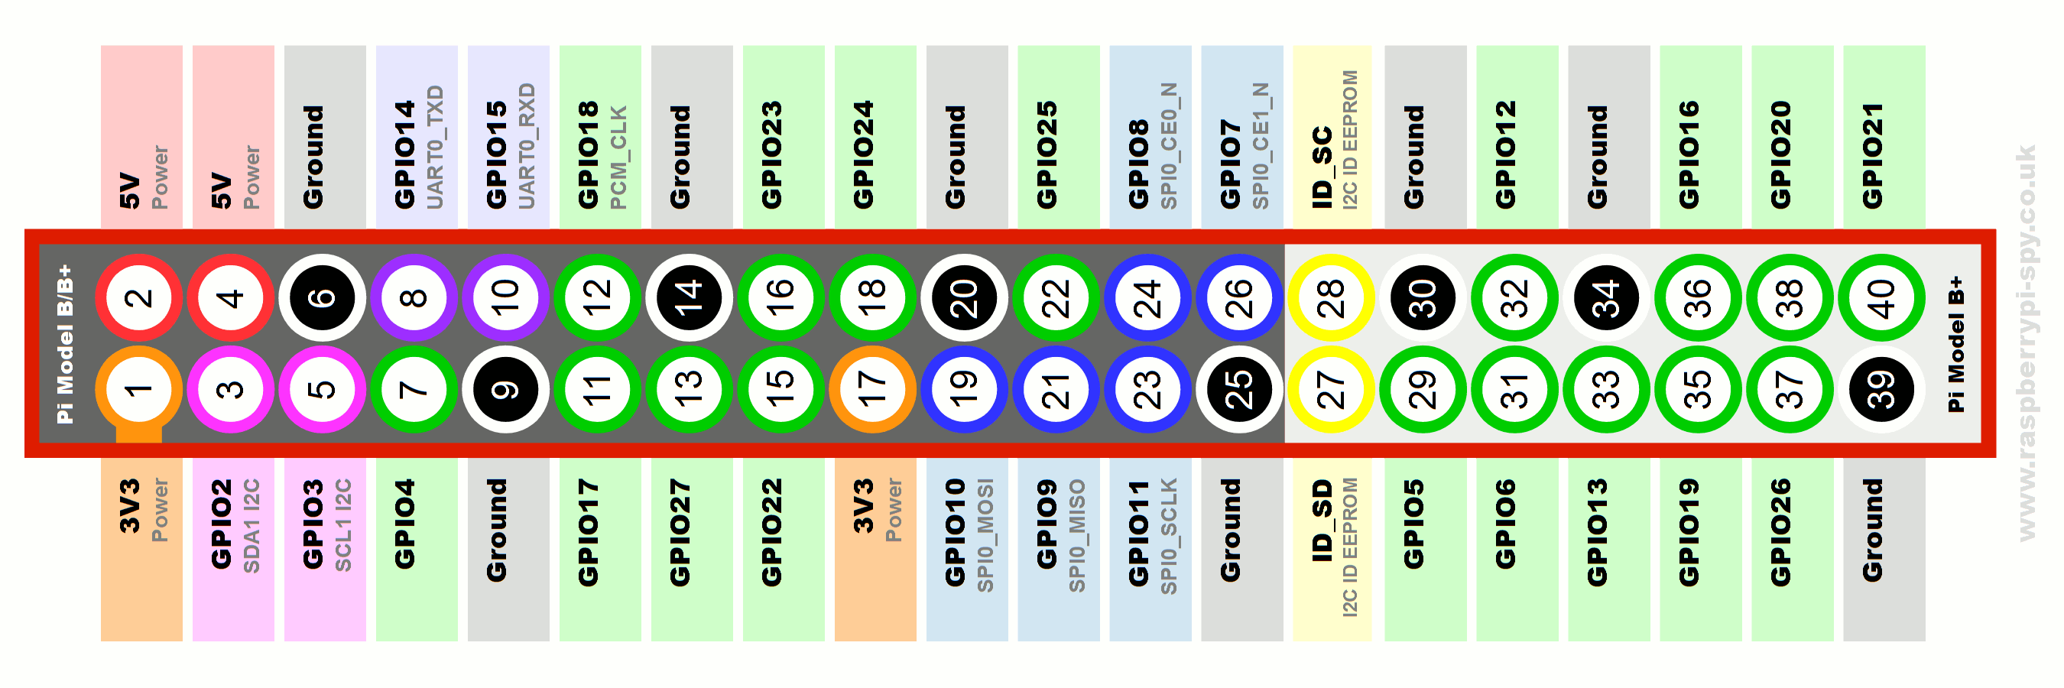

Slide 39
GPIO:
Act as both digital output and digital input.
Output: turn a GPIO pin high or low.
Input: detect a GPIO pin high or low
Installing GPIO library:
Open terminal
Enter the command ―sudoapt-get install python-dev” to install python development Enter the command “sudoapt-get install python- rpi.gpio” to install GPIO library.

Slide 40
Basic python coding: Open terminal enter the command sudonanofilename.py
This will open the nano editor where you can write your code Ctrl+O : Writes the code to the file Ctrl+X : Exits the editor

Slide 41
Blinking LED Code:
import RPi.GPIO as GPIO #GPIO library import time
GPIO.setmode(GPIO.BOARD) # Set the type of board for pin
numbering GPIO.setup(11, GPIO.OUT) # Set GPIO pin 11as output
pin
for i in range (0,5):
GPIO.output(11,True) # Turn on GPIO pin 11 time.sleep(1) GPIO.output(11,False)
Time.sleep(2)
GPIO.output(11,Tr ue)
GPIO.cleanup()

Slide 42
Power Pins
The header provides 5V on Pin 2 and 3.3V on Pin 1. The 3.3V supply is limited to 50mA. The 5V supply draws current directly from your microUSB supply so can use whatever is left over after the board has taken its share. A 1A power supply could supply up to 300mA once the Board has drawn 700mA.
Basic GPIO
The header provides 17 Pins that can be configured as inputs and outputs. By default they are all configured as inputs except GPIO 14 & 15.

Slide 43
Raspberry Pi Terminal Commands
[sudo apt-get update] - Update Package Lists
[sudo apt-get upgrade] - Download and Install Updated Packages
[sudoraspi-config] - The Raspberry Pi
Configuration Tool
[sudo apt-get clean] - Clean Old Package Files
[sudo reboot] - Restart your Raspberry Pi
[sudo halt] - Shut down your Raspberry Pi

Slide 44
Introduction to Intel® Galileo Boards
This is the first installment of tutorials designed to get you using your Intel® Galileo Board.
After completing this lesson, you will:
Understand the basic structure of Arduino* programs.
Write code in proper syntax.
Get an overview of the Arduino user interface.
Engage in your first set challenges.

Slide 45
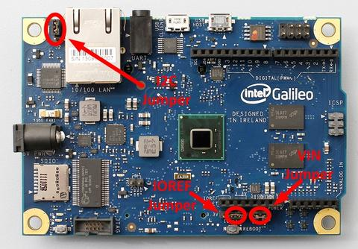

Slide 46
Features of the Intel® Galileo Board
Arduino
The Intel Galileo Board is the first Arduino board based on Intel architecture. The headers (what you connect jumper cables to on the board) are based off the Arduino 1.0 pinout model that's found on the Arduino Uno R3 boards. This provides the ability to use compatible shields (modules that you can plug into headers), allowing you to extend the functionality of the board. Like the Uno, it has 14 digital I/O pins, 6 analog inputs, a serial port, and an ICSP header for serial programming.

Slide 47
Quark
The board features an Intel® Quark SoC X1000 Application Processor, designed for the Internet of Things. It's smaller and more power efficient than the Intel Atom® Processor, making it great for small, low-powered projects.
Ethernet
On the top portion of the board, right next to what looks like an audio jack labeled UART, there is a 100 Mb Ethernet port that allows the Intel Galileo to connect to wired networks. Once your board is connected to the Internet, anything is possible.

Slide 48
Mini-PCIe
The Intel Galileo is the first Arduino Certified board that provides a mini PCI Express (mPCIe) slot. This allows you to connect standard mPCIe modules like Wi-Fi, Bluetooth, and SIM card adapters for cell phones.
Real Time Clock (RTC)
Synchronize data between modules using the boards-integrated Real Time Clock. Using the Arduino Time Library, you can add timekeeping functionality to your program. Wireless projects can synchronize in real time using the Network Time Protocol (NTP) and Global Positioning System (GPS) time data.

Slide 49
Micro SD
Use the optional onboard micro SD card reader that is accessible through the Secure Digital (SD) Library. Using a micro SD card, you can store up to 32 GB of data!
Linux*
Using the Linux image for the Intel Galileo, you can access serial ports, Wi-Fi, and board pins using programming languages like Advanced Linux Sound Architecture (ALSA), Video4Linux (V4L2), Python, Secure Shell (SSH), Node.js, and OpenCV.

Slide 51
Arduino* IDE Tutorial
Required equipment:
Intel® Galileo Board
Power supply (included in the box)
Micro USB cable (Type B)
Installed and configured Arduino* software v 1.5.3
Sample sketch
When you create a file in Arduino* software, it opens up a sketch with the basic layout of an Arduino program. Here is the user interface:

Slide 52
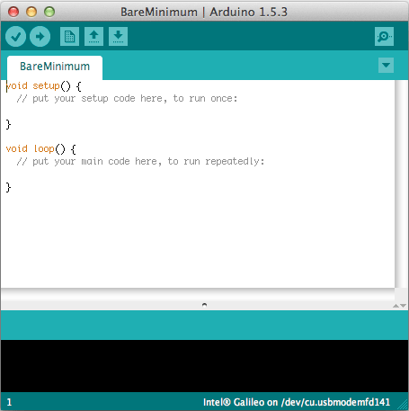

Slide 53
Comments
The two forward slashes (between the {and}) represent the beginning of an inline code comment. When your code is uploaded to the board, the compiler ignores the text after the two slashes. Using the inline code comment allows you to leave notes for yourself, and for people reading your code. You can also write multiline comments by starting your comment with /* and ending with */.
/* You are reading an example of a comment that has many lines. */

Slide 54
Variables
Passing around data throughout a program can get messy quick. Variables are like storage containers that hold different types of values. Using variables to pass values around is a great way to keep your code organized and readable.
When declaring a variable (introducing it into the program), choosing the right data type is important. If you are trying to measure light intensity using a photometer, you might want a precise reading. Declaring a variable type of double reserves space in memory for a number with a decimal point.

Slide 55
Hello World Example for Intel® Galileo Boards
Pin 13
This content might look familiar if you've completed Intel® Galileo Board Getting Started.
Pin 13 has an LED connected to it. You can run your first sketch by accessing this onboard LED. This is the first step in connecting external LEDs and modules.

Slide 56
Load sketch
The Arduino* software comes with code examples showing how to use some of the available modules for the Intel® Galileo Board. To run your first sketch, go to File > Examples > 01.Basics > Blink.
You should already have a connection with the serial port. To confirm, check out the bottom right side of the Arduino Integrated Development Environment.

Slide 57
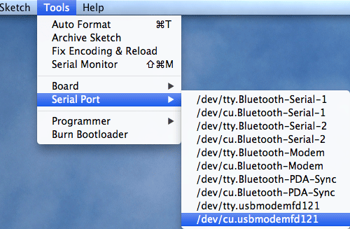

Slide 58
Your serial port ID might be different. Simply select the one starting with cu.usbmodem. If you are using Windows*, the port begins with COM.
When you're ready to run your sketch, go to: File > Upload.
Once the sketch uploads, you should see an LED on the board blinking. This blinking LED is programmatically associated with pin 13.

Slide 59
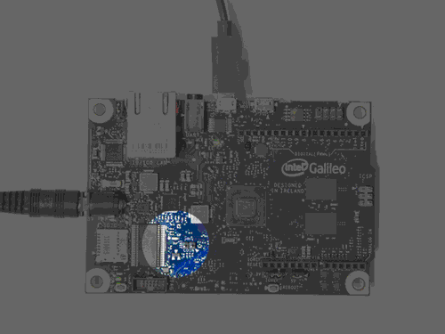

Slide 60
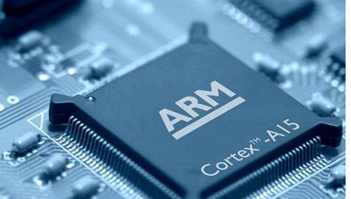
ARM Cortex

Slide 61
The ARM microcontroller stands for Advance RISC Machine; it is one of the extensive and most licensed processor cores in the world. The first ARM processor was developed in the year 1978 by Cambridge University, and the first ARM RISC processor was produced by the Acorn Group of Computers in the year 1985. These processors are specifically used in portable devices like digital cameras, mobile phones, home networking modules and wireless communication technologies and other embedded systems due to the benefits, such as low power consumption, reasonable performance, etc. This article gives an overview of ARM architecture with each module’s principle of working.

Slide 62
ARM Architecture
The ARM architecture processor is an advanced reduced instruction set computing [RISC] machine and it’s a 32bit reduced instruction set computer (RISC) microcontroller. It was introduced by the Acron computer organization in 1987. This ARM is a family of microcontroller developed by makers like ST Microelectronics,Motorola, and so on. The ARM architecture comes with totally different versions like ARMv1, ARMv2, etc., and, each one has its own advantage and disadvantages.

Slide 63
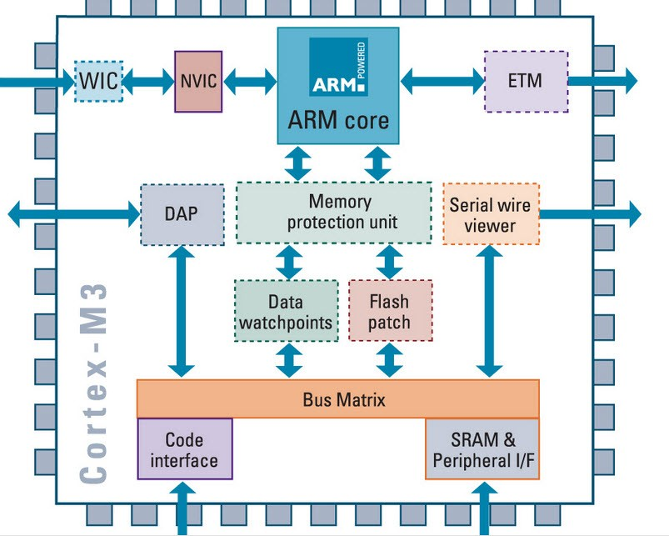

Slide 64
The ARM Architecture
Arithmetic Logic Unit
Booth multiplier
Barrel shifter
Control unit
Register file

Slide 65
Priority encoder: The encoder is used in the multiple load and store instruction to point which register within the register file to be loaded or kept.
Multiplexers: several multiplexers are accustomed to the management operation of the processor buses. Because of the restricted project time, we tend to implement these components in a very behavioral model. Each component is described with an entity. Every entity has its own architecture, which can be optimized for certain necessities depending on its application. This creates the design easier to construct and maintain.

Slide 66
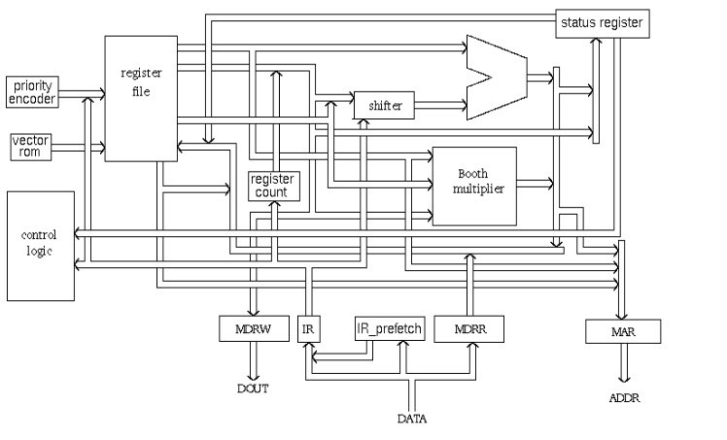

Slide 67
Arithmetic Logic Unit (ALU)
The ALU has two 32-bits inputs. The primary comes from the register file, whereas the other comes from the shifter. Status registers flags modified by the ALU outputs. The V-bit output goes to the V flag as well as the Count goes to the C flag.
Booth Multiplier Factor
The multiplier factor has 3 32-bit inputs and the inputs return from the register file. The multiplier output is barely 32-Least Significant Bits of the merchandise. The entity representation of the multiplier factor is shown in the above block diagram.

Slide 68
Booth Algorithm
Booth algorithm is a noteworthy multiplication algorithmic rule for 2’s complement numbers. This treats positive and negative numbers uniformly. Moreover, the runs of 0’s or 1’s within the multiplier factor are skipped over without any addition or subtraction being performed, thereby creating possible quicker multiplication.

Slide 69
Barrel Shifter
The barrel shifter features a 32-bit input to be shifted. This input is coming back from the register file or it might be immediate data. The shifter has different control inputs coming back from the instruction register. The Shift field within the instruction controls the operation of the barrel shifter.

Slide 70
Control Unit
For any microprocessor, control unit is the heart of the whole process and it is responsible for the system operation, so the control unit design is the most important part within the whole design. The control unit is sometimes a pure combinational circuit design. Here, the control unit is implemented by easy state machine. The processor timing is additionally included within the control unit.

Slide 71
ARM Microcontroller Register Modes
An ARM microcontroller is a load store reducing instruction set computer architecture means the core cannot directly operate with the memory. The data operations must be done by the registers and the information is stored in the memory by an address. The ARM cortex-M3 consists of 37 register sets wherein 31 are general purpose registers and 6 are status registers. The ARM uses seven processing modes to run the user task.

Slide 72
USER Mode
FIQ Mode
IRQ Mode
SVC Mode
UNDEFINED Mode
ABORT Mode
Monitor Mode

Slide 73
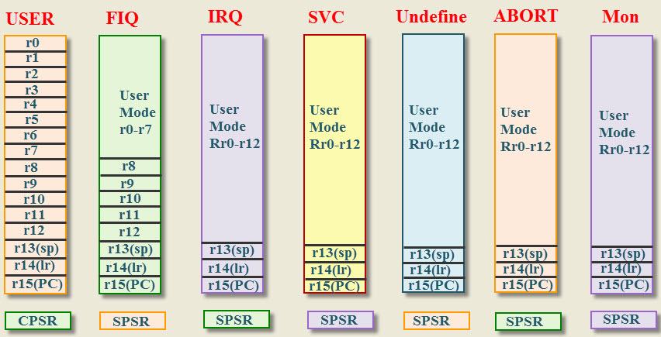

Slide 74
USER Mode: The user mode is a normal mode, which has the least number of registers. It doesn’t have SPSR and has limited access to the CPSR.
FIQ and IRQ: The FIQ and IRQ are the two interrupt caused modes of the CPU. The FIQ is processing interrupt and IRQ is standard interrupt. The FIQ mode has additional five banked registers to provide more flexibility and high performance when critical interrupts are handled.
SVC Mode: The Supervisor mode is the software interrupt mode of the processor to start up or reset.

Slide 75
Undefined Mode: The Undefined mode traps when illegal instructions are executed. The ARM core consists of 32-bit data bus and faster data flow.
THUMB Mode: In THUMB mode 32-bit data is divided into 16-bits and increases the processing speed.
THUMB-2 Mode: In THUMB-2 mode the instructions can be either 16-bit or 32-bit and it increases the performance of the ARM cortex –M3 microcontroller. The ARM cortex-m3 microcontroller uses only THUMB-2 instructions.

Slide 76
Some of the registers are reserved in each mode for the specific use of the core. The reserved registers are
Stack Pointer (SP).
Link Register (LR).
Program Counter (PC).
Current Program Status Register (CPSR).

Slide 77
Saved Program Status Register (SPSR).
The reserved registers are used for specific functions. The SPSR and CPSR contain the status control bits which are used to store the temporary data. The SPSR and CPSR register have some properties that are defined operating modes, Interrupt enable or disable flags and ALU status flag. The ARM core operates in two states 32-bit state or THUMBS state.

Slide 78
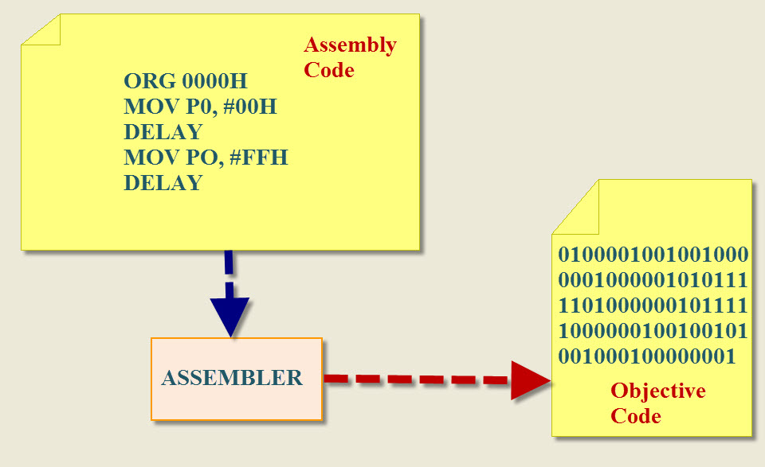
ARM-Cortex Microcontroller Programming

Slide 79
Additional Uses of the Cortex Processor
It is a reduced instruction set computing Controller
32-bit high performance central processing unit
3-stage pipeline and compact one
It has THUMB-2 technology
Merges optimally with 16/32 bit instructions
High performance

Slide 80
It supports tools and RTOS and its core Sight debug and trace
JTAG or 2-pin serial wire debugs connection
Support for multiple processors
Low power Modes
It supports sleep modes
Control the software package
Nested vectored interrupt controller (NVIC)
Low latency, low noise interrupts response
No need for assembly programming

Slide 81
Arduino
Arduino is an open-source platform used for building electronics projects. Arduino consists of both a physical programmable circuit board (often referred to as a microcontroller) and a piece of software, or IDE (Integrated Development Environment) that runs on your computer, used to write and upload computer code to the physical board. Accepts analog and digital signals as input and gives desired output.

Slide 82
BOARD DETAILS:
Power Supply:
USB or power barrel jack
Voltage Regulator
LED Power Indicator
Tx-Rx LED Indicator
Output power,
Ground
Analog Input Pins
Digital I/O Pin

Slide 83
ARDUIN0 UN0
Feature | Value
Operating Voltage | 5V
Clock Speed | 16MHz
Digital I/O | 14
Analog Input | 6
PWM | 6
UART | 1
Interface | USB via ATMega16U2

Slide 84
TYPES:
Arduino Uno (R3)
LilyPad Arduino
RedBoard
Arduino Mega (R3)

Slide 85
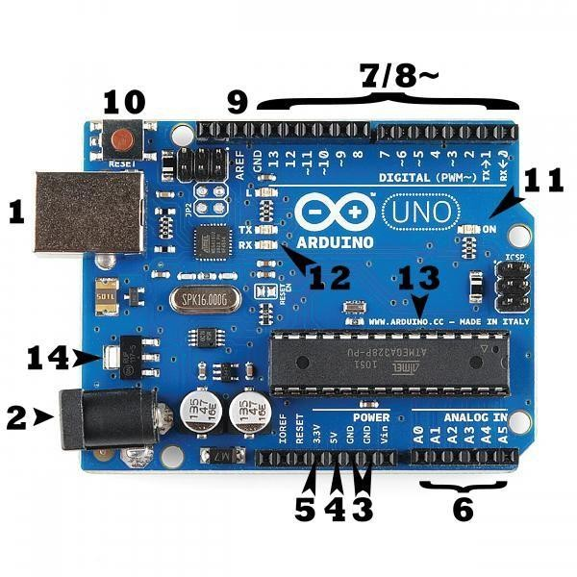

Slide 86
Power (USB / Barrel Jack):
Every Arduino board needs a way to be connected to a power source. The Arduino UNO can be powered from a USB cable coming from your computer or a wall power supply (like this) that is terminated in a barrel jack. In the picture above the USB connection is labeled (1) and the barrel jack is labeled (2).The USB connection is also how you will load code onto your Arduino board.

Slide 87
Pins (5V, 3.3V, GND, Analog, Digital, PWM, AREF):
The pins on your Arduino are the places where you connect wires to construct a circuit (probably in conjunction with a breadboard and some wire. They usually have black plastic ‗headers‘that allow you to just plug a wire right into the board. The Arduino has several different kinds of pins, each of which is labeled on the board and used for different functions.
GND (3): Short for ‗Ground‘. There are several GND pins on the Arduino, any of which can be used to ground your circuit.

Slide 88
5V (4) & 3.3V (5): As you might guess, the 5V pin supplies 5 volts of power, and the 3.3V pin supplies 3.3 volts of power. Most of the simple components used with the Arduino run happily off of 5 or 3.3 volts.
Analog (6): The area of pins under the ‗Analog in‘label (A0 through A5 on the UNO) are Analog In pins. These pins can read the signal from an analog sensor (like a temperature sensor) and convert it into a digital value that we can read.

Slide 89
Digital (7): Across from the analog pins are the digital pins (0 through 13 on the UNO). These pins can be used for both digital input (like telling if a button is pushed) and digital output (like powering an LED).
PWM (8): You may have noticed the tilde (~) next to some of the digital pins (3, 5, 6, 9, 10, and 11 on the UNO). These pins act as normal digital pins, but can also be used for something called Pulse-Width Modulation (PWM). We have a tutorial on PWM, but for now, think of these pins as being able to simulate analog output (like fading an LED in and out).

Slide 90
AREF (9): Stands for Analog Reference. Most of the time you can leave this pin alone. It is sometimes used to set an external reference voltage (between 0 and 5 Volts) as the upper limit for the analog input pins.
Reset Button
Just like the original Nintendo, the Arduino has a reset button (10). Pushing it will temporarily connect the reset pin to ground and restart any code that is loaded on the Arduino. This can be very useful if your code doesn‘t repeat, but you want to test it multiple times. Unlike the original Nintendo however, blowing on the Arduino doesn‘t usually fix any problems.

Slide 91
ARDINO IDE OVERVIEW:
Program coded in Arduino IDE is called a SKETCH
To create a new sketch File -> New
To open an existing sketch File -> open ->
There are some basic ready-to-use sketches available in the EXAMPLES section File -> Examples -> select any program
Verify: Checks the code for compilation errors
Upload: Uploads the final code to the controller board
New: Creates a new blank sketch with basic structure
Open: Opens an existing sketch

Slide 92
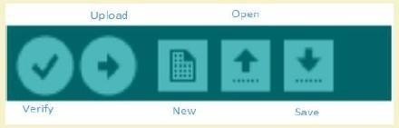
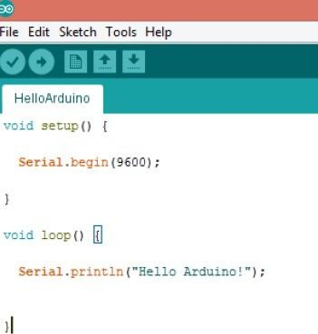

Slide 93
A sketch can be divided into two parts:
Setup ()
Loop ()
The function setup () is the point where the code starts, just like the main () function in C and C++ I/O Variables, pin modes are initialized in the Setup () function
Loop() function, as the name suggests, iterates the specified task in the program DATA TYPES:
Void, Long, Int, Char, Boolean, Unsigned char, Byte, Unsigned int, Word ,Unsigned long ,Float, Double, Array,String-char array, String-object, Short

Slide 94
EXAMPLE BLINKING LED:
Requirement:
Arduino controller board, USB connector, Bread board, LED, 1.4Kohm resistor, connecting wires, Arduino IDE
Connect the LED to the Arduino using the Bread board and the connecting wires
Connect the Arduino board to the PC using the USB connector
Select the board type and port ▪ Write the sketch in the editor, verify andupload Connect the positive terminal of the LED to digital pin 12 and the negative terminal to the ground pin (GND) of Arduino Board

Slide 95
void setup()
{
pinMode(12, OUTPUT); // set the pin mode
} void loop()
{
digitalWrite(12, HIGH); // Turn on the LED delay(1000); digitalWrite(12, LOW); //Turn of the LED delay(1000);
}

Slide 96
Set the pin mode as output which is connected to the led, pin 12 in this case. Use digitalWrite() function to set the output as HIGH and LOW
Delay () function is used to specify the delay between HIGH-LOW transition of the output
Connect he board to the PC
Set the port and board type
Verify the code and upload, notice the TX – RX led in the board starts flashing as the code is uploaded.

Slide 97
Soil Moisture Monitoring
Soil moisture sensors measure the volumetric water content in soil. Since the direct gravimetric measurement of free soil moisture requires removing, drying, and weighting of a sample, soil moisture sensors measure the volumetric water content indirectly by using some other property of the soil, such as electrical resistance, dielectric constant, or interaction with neutrons, as a proxy for the moisture content

Slide 98
The relation between the measured property and soil moisture must be calibrated and may vary depending on environmental factors such as soil type, temperature, or electric conductivity. Reflected microwave radiation is affected by the soil moisture and is used for remote sensing in hydrology and agriculture.

Slide 99
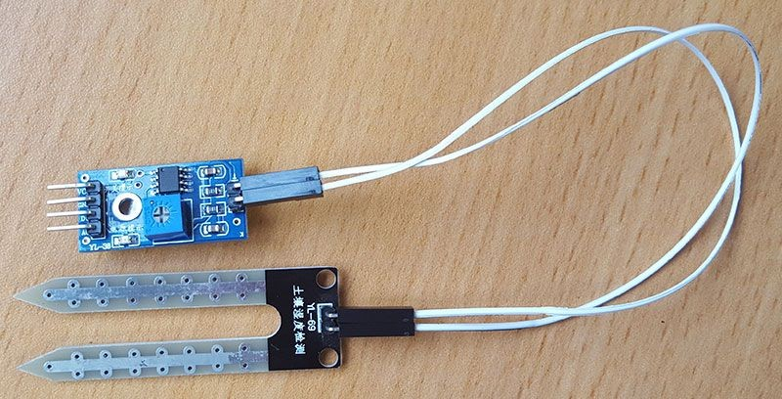

Slide 100
Now let’s wire the sensor to the Raspberry Pi.
VCC-->3v3
GND --> GND
D0 --> GPIO 17 (Pin 11)
With everything now wired up, we can turn on the Raspberry Pi. Without writing any code we can test to see our moisture sensor working. When the sensor detects moisture, a second led will illuminate.

Slide 101
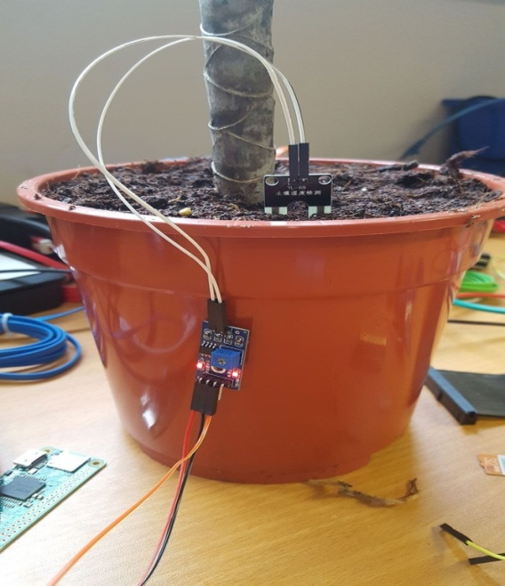
So as a quick test, grab a glass of water (be very careful not to spill water!!) then place the probes into the water and see the detection led shine. If the detection light doesn’t illuminate, you can adjust the potentiometer on the sensor which allows you to change the detection threshold (this only applies to the digital output signal)

Slide 102
1.1 Code
import RPi.GPIO as GPIO import smtplib
import time
smtp_username = "enter_username_here" # This is the username used to login to your SMTP provider
smtp_password = "enter_password_here" # This is the password used to login to your SMTP provider

Slide 103
smtp_host = "enter_host_here" # This is the host of the SMTP provider smtp_port = 25 # This is the port that your SMTP provider uses smtp_sender = "sender@email.com" # This is the FROM email address smtp_receivers = ['receiver@email.com'] # This is the TO email address message_dead = """From: Sender Name <sender@email.com>
Name <sender@email.com>
To: Receiver Name <receiver@email.com>
Subject: Moisture Sensor Notification

Slide 104
# This is the message that will be sent when moisture IS detected again message_alive = """From: Sender Name <sender@email.com>
To: Receiver Name <receiver@email.com>
Subject: Moisture Sensor Notification # This is our sendEmail function
def sendEmail(smtp_message): try:
smtpObj = smtplib.SMTP(smtp_host, smtp_port)
smtpObj.login(smtp_username, smtp_password) # If you don't need to login to your smtp provider, simply remove this line

Slide 105
smtpObj.sendmail(smtp_sender, smtp_receivers, smtp_message) print "Successfully sent email" except smtplib.SMTPException: print "Error: unable to send email"
# This is our callback function, this function will be called every time there is a change on the specified GPIO channel, in this example we are using 17
def callback(channel):
if GPIO.input(channel): print "LED off" sendEmail(message_dead)
Else: print "LED on" sendEmail(message_alive)
# Set our GPIO numbering to BCM GPIO.setmode(GPIO.BCM)

Slide 106
# Define the GPIO pin that we have our digital output from our sensor connected to channel = 17
# Set the GPIO pin to an input GPIO.setup(channel, GPIO.IN)
# This line tells our script to keep an eye on our gpio pin and let us know when the pin goes HIGH or LOW
GPIO.add_event_detect(channel, GPIO.BOTH, bouncetime=300)
# This line assigns a function to the GPIO pin so that when the above line tells us there is a change on the pin, run this function

Slide 107
GPIO.add_event_callback(channel, callback)
# This is an infinte loop to keep our script running while True:
# This line simply tells our script to wait 0.1 of a second, this is so the script doesnt hog all of the CPU
time.sleep(0.1)

Slide 108
Weather monitoring
The DHT11 is a low-cost temperature and humidity sensor. It isn’t the fastest sensor around but its cheap price makes it useful for experimenting or projects where you don’t require new readings multiple times a second. The device only requires three connections to the Pi.
+3.3v, ground and one GPIO pin.

Slide 109
DHT11 Specifications
The device itself has four pins but one of these is not used. You can buy the 4-pin device on its own or as part of a 3-pin module. The modules have three pins and are easy to connect directly to the Pi’s GPIO header.
Humidity: 20-80% (5% accuracy)
Temperature: 0-50°C (±2°C accuracy)

Slide 110
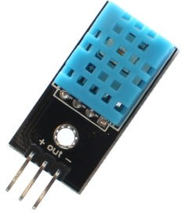

Slide 111
The 4-pin device will require a resistor (4.7K-10K) to be placed between Pin 1 (3.3V) and Pin 2 (Data). The 3-pin modules will usually have this resistor included which makes the wiring a bit easier. The 3 pins should be connected to the Pi as shown in the table below:
DHT Pin | Signal | Pi Pin
1 | 3.3V | 1
2 | Data/Out | 11 (GPIO17)
3 | Not used | –
4 | Ground | 6 or 9

Slide 112
Python Library
The DHT11 requires a specific protocol to be applied to the data pin. In order to save time trying to implement this yourself it’s far easier to use the Adafruit DHT library. The library deals with the data that needs to be exchanged with the sensor but it is sensitive to timing issues.

Slide 113
Air Quality Monitoring
Air pollution is a major problem in urban centers as well as rural set-up. The major pollutants of concern are primarily carbon monoxide, nitrogen oxides, hydrocarbons and particulate matter (PM10, PM2.5). Ozone, PAN and PBN are other secondary pollutants generated as a result of the photochemical reactions of the primary pollutants.

Slide 114
These pollutants affect human health as well as environment. Therefore, air pollution monitoring is necessary to keep a check on the concentration of these pollutants in ambient air. The grove sensors, grove DHT (for temperature and humidity), grove gas sensor modules like dust, MQ-5 (for smoke), MQ-7 (for CO) and MQ-135 (for CO2) are interfaced to this shield for monitoring in our proposed.

Slide 115
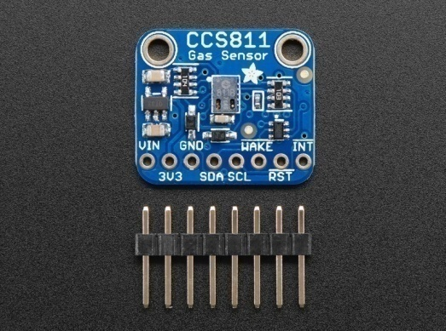

Slide 116
Power Pins
• Vin - this is the power pin. Since the sensor uses 3.3V, we have included an onboard voltage regulator that will take 3-5VDC and safely convert it down. To power the board, give it the same power as the logic level of your microcontroller - e.g. for a 5V micro like Arduino, use 5V
• 3Vo - this is the 3.3V output from the voltage regulator, you can grab up to 100mA from this if you like
• GND - common ground for power and logic

Slide 117
Logic pins
• SCL - this is the I2C clock pin, connect to your microcontrollers I2C clock line. There is a 10K pull-up on this pin and it is level shifted so you can use 3 - 5VDC.
• SDA - this is the I2C data pin, connect to your microcontrollers I2C data line. There is a 10K pull-up on this pin and it is level shifted so you can use 3 - 5VDC.
• INT - this is the interrupt-output pin. It is 3V logic and you can use it to detect when a new reading is ready or when a reading gets too high or too low.

Slide 118
• WAKE - this is the wakeup pin for the sensor. It needs to be pulled to ground in order to communicate with the sensor. This pin is level shifted so you can use 3- 5VDC logic.
• RST - this is the reset pin. When it is pulled to ground the sensor resets itself. This pin is level shifted so you can use 3-5VDC logic.

Slide 119
Raspberry Pi Wiring & Test
The Raspberry Pi also has an I2C interface that can be used to communicate with this sensor. Once your Pi is all set up, and you have internet access set up, let’s install the software we will need. First make sure your Pi package manager is up to date

Slide 120
from time import sleep
from Adafruit_CCS811 import Adafruit_CCS811 ccs = Adafruit_CCS811()
while not ccs.available(): pass
temp = ccs.calculateTemperature() ccs.tempOffset = temp - 25.0
while(1):
if ccs.available():
temp = ccs.calculateTemperature() if not ccs.readData():
print "CO2: ", ccs.geteCO2(), "ppm, TVOC: ", ccs.getTVOC(), " temp: ", temp else:
print "ERROR!" while(1):
pass sleep(2)

Slide 121
Movement Detection
PIR stands for passive infrared. This motion sensor consists of a fresnel lens, an infrared detector, and supporting detection circuitry. The lens on the sensor focuses any infrared radiation present around it toward the infrared detector. Our bodies generate infrared heat, and as a result, this heat is picked up by the motion sensor. The sensor outputs a 5V signal for a period of one minute as soon as it detects the presence of a person. It offers a tentative range of detection of about 6–7 meters and is highly sensitive.

Slide 122
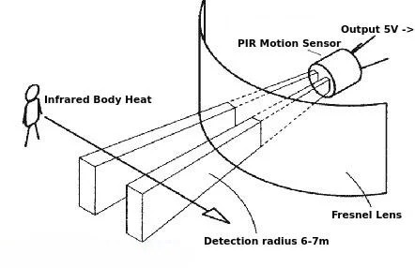

Slide 123
Working Mechanism
All living beings radiate energy to the surroundings in the form of infrared radiations which are invisible to human eyes. A PIR (Passive infrared) sensor can be used to detect these passive radiations. When an object (human or animal) emitting infrared radiations passes through the field of view of the sensor, it detects the change in temperature and therefore can be used to detect motion.HC-SR501 uses differential detection with two pyroelectric infrared sensors. By taking a difference of the values, the average temperature from the field of view of a sensor is removed and thereby reducing false positives.

Slide 124
import RPi.GPIO as GPIO import time #Import time library
GPIO.setmode(GPIO.BOARD) #Set GPIO pin numbering pir = 26 #Associate pin 26 to pir
GPIO.setup(pir, GPIO.IN) #Set pin as GPIO in print "Waiting for sensor to settle" time.sleep(2) #Waiting 2 seconds for the sensor to initiate print "Detecting motion"
while True:
if GPIO.input(pir): #Check whether pir is HIGH print "Motion Detected!" time.sleep(2) #D1- Delay to avoid multiple detection
time.sleep(0.1) #While loop delay should be less than detection(hardware) delay

